Slide 1


Illinois Sentencing Policy Advisory Council
September 17, 2021 Meeting

Slide 2
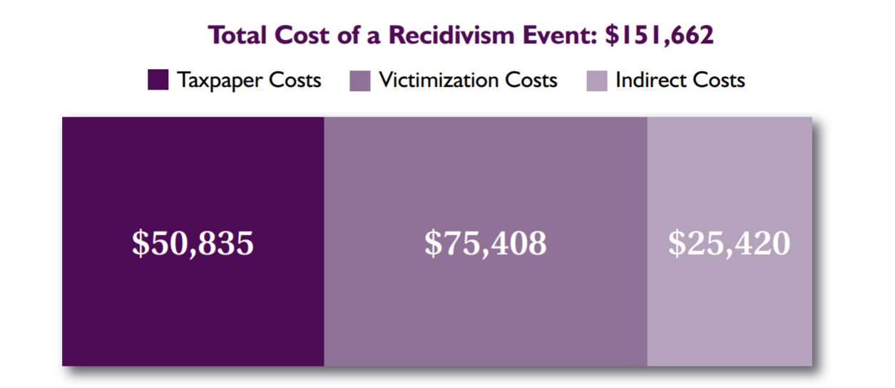
The High Cost of Recidivism

Slide 3
Fiscal Impacts - Demographics Example

Slide 4
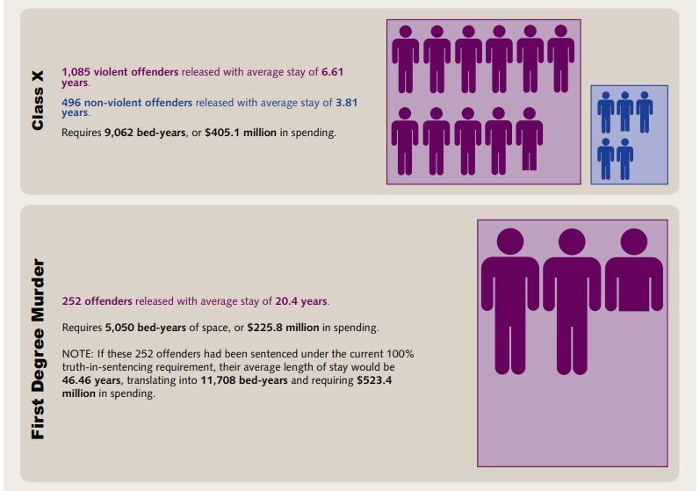

Slide 5
Rapid Response
SB3441 Repeat Gun Offender Predicate Breakdown

Slide 6
SPAC’s Greatest Hits
Prison Pies
Average Offender Profiles
Non-Probationable list

Slide 7
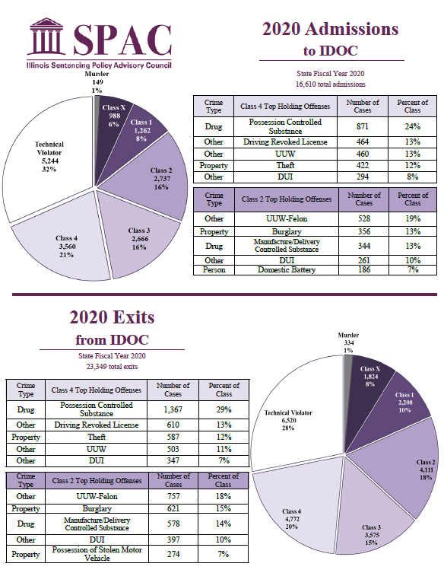
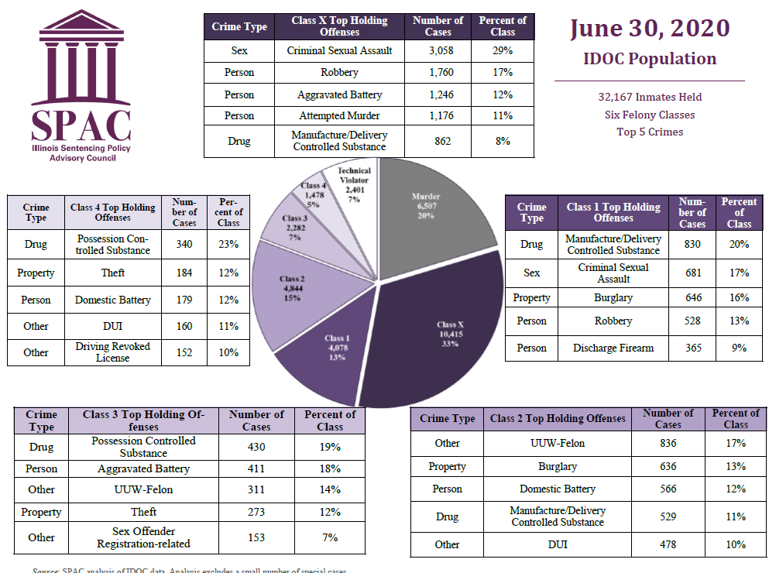
Prison Pies

Slide 8
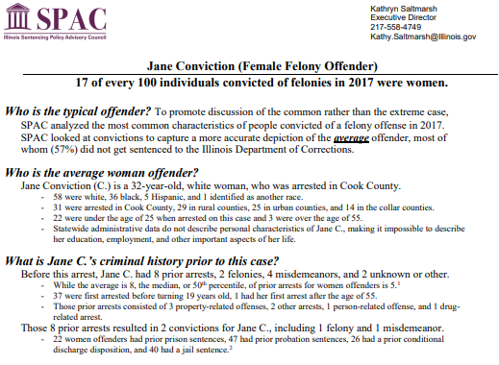
Average (Female) Offenders

Slide 9
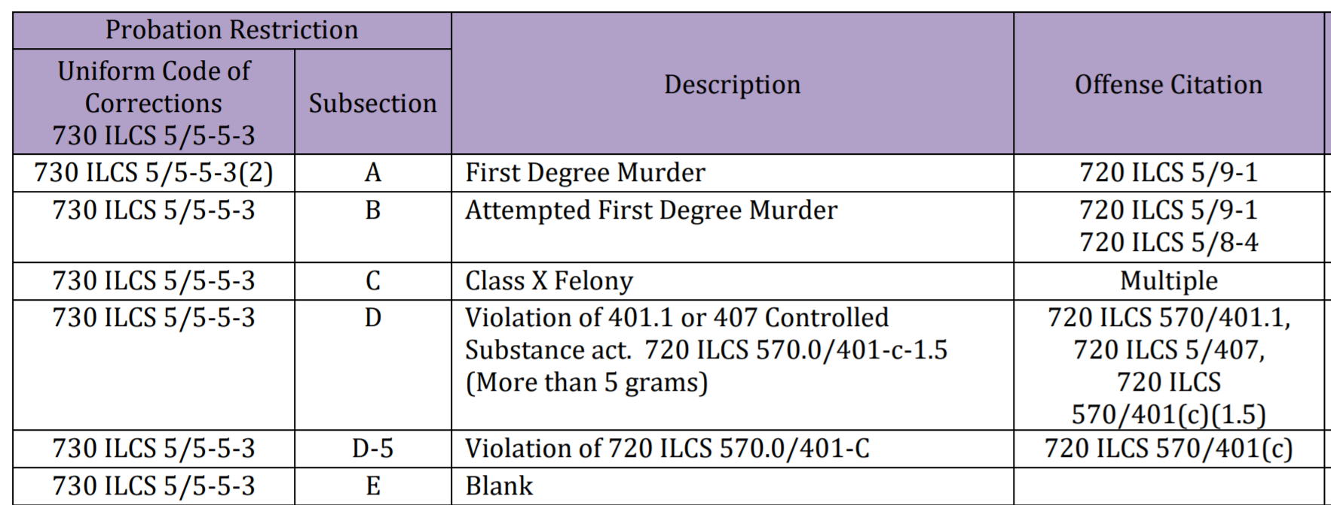
Non-Probationable List
SPAC’s Non-Probationable List

Slide 10
SPAC Access to case-level data
IDOC P&R Data
Circuit Clerk data
Offender 360
De-identified CHRI
Identified CHRI
AOIC-ADR
2011
2021

Slide 11
Doing the Needed Research
SPAC-Initiated Reports
  Misdemeanor Sentencing Report
  Longitudinal Prison Use & Adult Redeploy
Statutorily Required Reports
  Pre-sentence Investigations for Class 3 and 4 Non-violent convictions with no prior probation
  Unlawful Use of Weapons Mandatory Minimum Sentence with Departure Possible

Slide 12
SPAC Analysis of UUW Sentences for those with predicate priors
After PA100-3 became effective, aggravated UUW and UUW-Felon were 3.2 and 2.5 times more likely to be sentenced to a longer term and sentences were on average about 5 and 4 months longer.
Changes were estimated after adjusting for other variables using multivariate regression models.

Slide 13
Data Gaps
Current data collection lacks:
  Value of stolen items in theft and retail theft
  Victim-offender relationships
  Felony murder & accountability
  Specific mass/quantities of drugs
  Firearm enhancements in long sentences
Case level probation data not yet available.
Insufficient data – doing the best we can with what we have
  Example – Theft and Retail Theft

Slide 14
Data Gaps – Solutions
National Incident-Based Reporting System (NIBRS).
Large increase in AOIC and IDOC data reported on their websites
  AOIC now has monthly probation data with numerous indicators; pretrial data collection ongoing.
  IDOC now publishes monthly or quarterly reports covering population, spending, and operations/management.
SPAC Aggravated UUW and UUW-Felon forms for departures from longer sentences.

Slide 15
What next?
Name one thing you would like SPAC to do differently.
Should SPAC focus more on non-prison sentences?
How can SPAC improve local stakeholder engagement?

